Slide 1
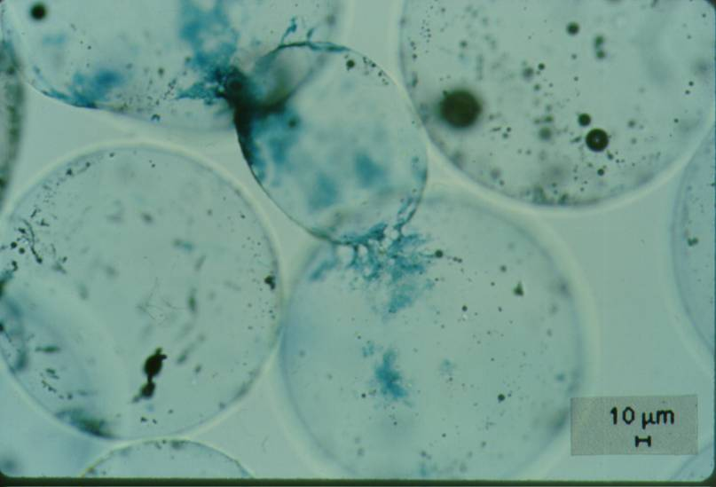
Contact Points

Slide 2
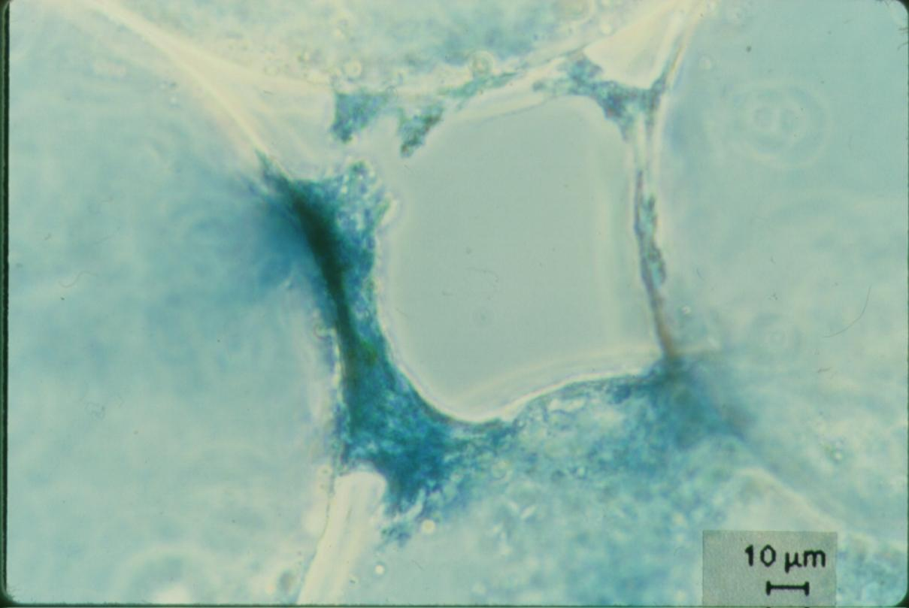
Polymer Accumulation in a Pore

Slide 3
Graphing Filter Performance
This graph gives the impression that you can reach 100% removal
Where is 99.9% removal?

Slide 4
Developing a Filtration Model
Iwasaki (1937) developed relationships describing the performance of deep bed filters.
C is the particle concentration [number/L³]
λ₀ is the initial filter coefficient [1/L]
z is the media depth [L]
The particle’s chances of being caught are the same at all depths in the filter; pC* is proportional to depth
Notes:
Iwasaki, T. (1937). "Some Notes on Sand Filtration." Journal American Water Works Association 29: 1591.

Slide 5
London van der Waals
The London Group is a measure of the attractive force
It is only effective at extremely short range (less than 1 nm) and thus is NOT responsible for transport to the collector
H is the Hamaker’s constant
Van der Waals force
Viscous force

Slide 6
What about Electrostatic repulsion/attraction?
Modelers have not succeeded in describing filter performance when electrostatic repulsion is significant
Models tend to predict no particle removal if electrostatic repulsion is significant.
Electrostatic repulsion/attraction is only effective at very short distances and thus is involved in attachment, not transport

Slide 7
Numerical Models
Trajectory analysis
A series of modeling attempts with refinements over the past decades
Began with a “single collector” model that modeled London and electrostatic forces as an attachment efficiency term (α)
Interception
Sedimentation
Diffusion
α
Notes:
Yao, K.-M., M. T. Habibian, et al. (1971). "Water and Waste Water Filtration: Concepts and Applications." Environmental Science and Technology 5(11): 1105.

Slide 8
Filtration Model
Porosity
Geometry
Force ratios

Slide 9
Transport Equations
Brownian motion
Interception
Gravity
Total is sum of parts
Transport is additive

Slide 10


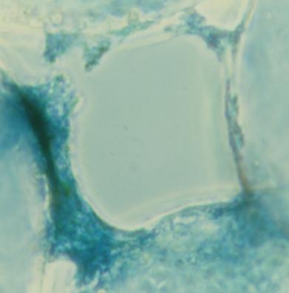
Slow Sand Filtration Mechanisms
Protozoan predators (only effective for bacteria removal, not virus or protozoan removal)
Aluminum (natural sticky coatings)
Attachment to previously removed particles
No evidence of removal by biofilms

Slide 11
Typical Performance of SSF Fed Cayuga Lake Water
1
Fraction of influent E. coli remaining in the effluent
0.1
0.05
0
1
2
3
4
5
Time (days)
(Daily samples)
Filter performance doesn’t improve if the filter only receives distilled water

Slide 12
Particle Removal by Size
1
control
Great for removing giardia (10 µm) and cryptosporidium (4 µm)
3 mM azide
0.1
Fraction of influent particles remaining in the effluent
Effect of the Chrysophyte
0.01
What is the physical-chemical mechanism?
0.001
0.8
1
Particle diameter (µm)
10

Slide 13
E. coli Removal as a Function of Time and Al Application Rate
20 cm deep filter columns
No E. coli detected
Alum
pC* is proportional to accumulated mass of Aluminum in filter
Notes:
This alum dose is below the solubility limit for aluminum. This needs to be verified!

Slide 14
Slow Sand Filtration Predictions
Notes:
If slow sand filters were sticky, they would be incredible. Poor attachment efficiency makes them very inefficient at clay removal.

Slide 15
How deep must a filter (SSF) be to remove 99.9999% of bacteria?
Assume α is 1 and d_{c} is 0.2 mm, V₀ = 0.03 mm/s
pC* is ____
z is ________________
What does this mean?
6
for z of 1 m
23 cm for pC* of 6
Suggests that the 20 cm deep experimental filter was operating at theoretical limit
Typical SSF performance is 95% bacteria removal
Only about 5 cm of the filters are doing anything!

Slide 16

Head Loss Produced by Aluminum in SSF

Slide 17
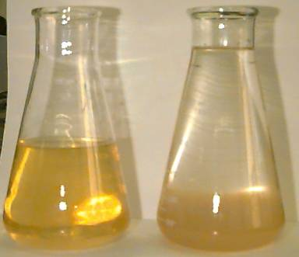
Cayuga Lake Seston Extract
Concentrate particles from Cayuga Lake
Acidify with 1 N HCl
Centrifuge
Centrate contains polymer
Neutralize to form flocs

Slide 18
Seston Extract Analysis
I discovered aluminum!
carbon
16%
How much Aluminum should be added to a filter?

Slide 19
Aluminum feed methods
Alum must be dissolved until it is blended with the main filter feed above the filter column
Alum flocs are ineffective at enhancing filter performance
The diffusion dilemma (alum microflocs will diffuse efficiently and be removed at the top of the filter)

Slide 20
Performance Deterioration after Al feed stops?
Hypotheses
Al washes out of filter
Decays with time
Sites are used up
Research results
Not yet clear which mechanism is responsible – further testing required

Slide 21
Sticky Media vs. Sticky Particles
Sticky Media
Potentially treat filter media at the beginning of each filter run
No need to add coagulants to water for low turbidity waters
Filter will capture particles much more efficiently
Sticky Particles
Easier to add coagulant to water than to coat the filter media

Slide 22
“BioSand” (Intermittent SSF – ISSF) Performance
Pore volume is 18 Liters
Volume of a bucket is ____________
Highly variable field performance even after initial ripening period
20 Liters
Field tests on 8 NTU water in the DR
http://www.iwaponline.com/wst/05403/0001/054030001.pdf
pC*
Notes:
http://www.iwaponline.com/wst/05403/0001/054030001.pdf

Slide 23
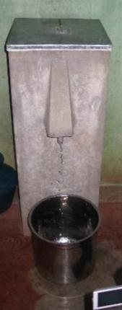
The “BioSand” Filter Craze
Intermittent Slow Sand Filters (ISSF)
Patented “new idea” of intermittent slow sand filtration without flow control and called it “BioSand”
Filters are being installed around the world as Point of Use treatment devices
Cost is somewhere between $25 and $150 per household ($13/person based on project near Copan Ruins, Honduras)
The per person cost is comparable to the cost to build centralized treatment using the AguaClara model

Slide 24
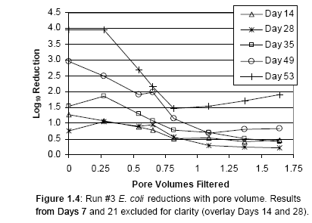
Intermittent Slow Sand Filter Performance
Notes:
The operation, flow conditions and microbial reductions of an intermittently operated, household-scale slow sand filter
M.A. Elliott*, C.E. Stauber, F. Koksal, K.R. Liang, D.K. Huslage, F.A. DiGiano, M.D. Sobsey.
*University of North Carolina, CB 7431, Chapel Hill, NC, 27514, USA.
Long ripening period
After pore volume is flushed has poor performance

Slide 25
Field Performance ISSF
Table 2 pH, turbidity and E. coli levels in raw and ISSF effluent in the field
Parameter raw filtered
Mean pH (n =47) 7.4 8.0
Mean turbidity (NTU) (n=47) 8.1 1.3
Mean log₁₀ E. coli MPN/100mL (n=55) 1.7 0.6
Turbidity pC*(0.8) and E. coli pC* (0.35) is poor and confirms that filters are NOT appropriate as a single treatment step for highly contaminated waters.
http://www.iwaponline.com/wst/05403/0001/054030001.pdf

Slide 26
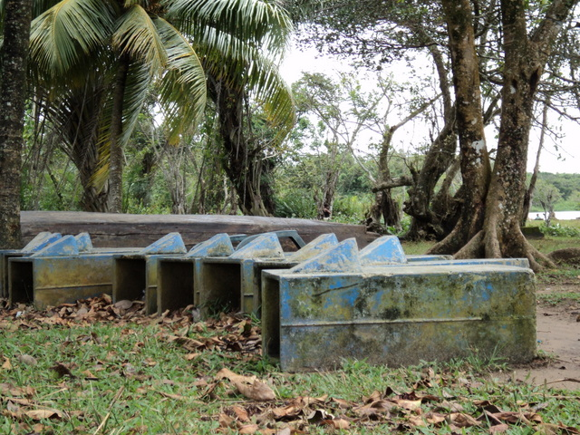
Notes:
Photo courtesy of Sarah Long taken In La Mosquitia, Honduras in October of 2010.

Slide 27
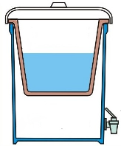
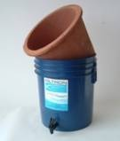
Potters for Peace Pots
Colloidal silver-enhanced ceramic water purifier (CWP)
After firing the filter is coated with colloidal silver.
This combination of fine pore size, and the bactericidal properties of colloidal silver produce an effective filter
Filter units are sold for about $10-15 with the basic plastic receptacle
Replacement filter elements cost about $4.00
What is the turbidity range that these filters can handle?
How do you wash the filter? What water do you use?

Slide 28




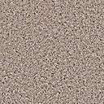
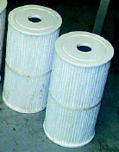
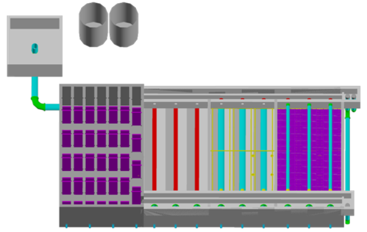

Filter range of applicability The “if it is dirty, filter it” Myth
SSF
RSF+
DE
Cartridge
Bag
Pot
Candle
1
10
*?
NTU
?
?
100
?
?
* Multi-Stage Filtration
1000
Notes:
http://www.lenntech.com/cartridgefilter-bagfilter.htm
http://www.nesc.wvu.edu/ndwc/pdf/OT/TB/OT_TB_su01.pdf on DE filters

Slide 29

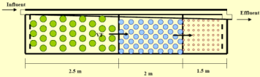
Filters Galore
Slow Sand
Bag
Rapid Sand
Pot
Stacked Rapid Sand
Intermittent Slow Sand
Rough
Candle

Slide 30
Filtration with pores partially filled with Aluminum Hydroxide
25% of void is filled with floc
Conventional performance
Notes:
Enhanced Particle Capture through Aluminum Hydroxide Addition to Pores in Sand Media
Authors: Po-Hsun Lin, Leonard W. Lion, and Monroe L. Weber-Shirk*

Slide 31
Filtration with pores partially filled with Aluminum Hydroxide
Alum fluidized-bed pretreatment. Particle removal (pC*) over time by a sand filter as a function of the pretreatment dose (mol Al/m³). Raw water pH was 7. The results were smoothed by averaging the raw data over 30 second intervals. No coagulant in feed!!!!
Notes:
Enhanced Particle Capture through Aluminum Hydroxide Addition to Pores in Sand Media
Authors: Po-Hsun Lin, Leonard W. Lion, and Monroe L. Weber-Shirk*

Slide 32
Need to devise fluidized bed equations
Base model on terminal velocity equations that transition into the turbulent regime
Equations will be

Slide 33
Fluidized bed equations
Calculate separation distance between sand grains
Use flat plate equations to get velocity gradients
We need average vertical shear on sand grain to get vertical force.
Set shear force equal to net gravity force
Calibrate equation by setting equal to Kozeny at fluidization initiation

Slide 34
Average Separation
Calculate vertical projection of sand grain surface area (or simple surface area)
Average horizontal distance between sand grains (center to center and then gap).
Use separation distance to calculate velocity gradient
* This method gets quite complex because boundary layer is developing over scale of a sand grain

Slide 35
Innovation Questions Key questions to ask
Why is this hard? (led to the StaRS)
What is the limitation of the existing design?
How could we change this geometry?
Turn it inside out
Rotate it
Shrink it
Expand it
Why are these our only options?
Could we cross pollinate our options?

Slide 36
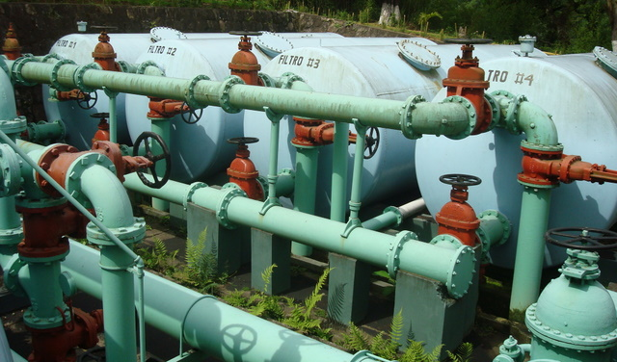
Alternative to deep filter boxes - Pressure RSF
Proper backwashing of a pressure filter is difficult because the filter sand is not visible to the operator.
Observation of the following are not possible
Presence of filter cracks or mudballs
Backwash water distribution
Uniformity of rate of cleanup of the wash water over the full filter area
Proper functioning of the auxiliary scour devices
Elevation and appearance of the top surface of the sand after the backwash
Extent of fluidization and bed expansion during backwash
Loss of filter media
Some state regulatory agencies prohibit use of pressure filters for drinking water treatment
Notes:
Page 8.73 in Water Quality and Treatment: A Handbook of Community Water Supplies. Fifth edition.
Photo is of abandoned filters at El Cambray water treatment plant in Guatemala City

